Slide 1
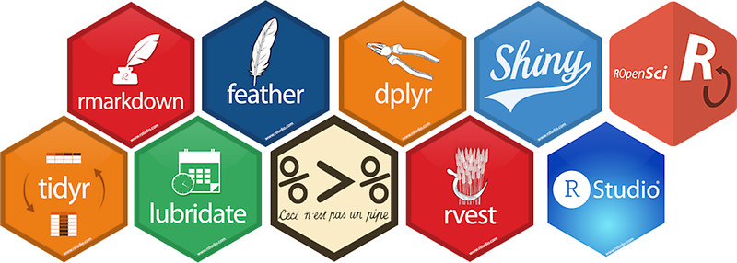
Using R as a Research Tool.
NERC E3 DTP Training – 5th November 2019
Dr Susan Johnston, Institute of Evolutionary Biology
Demonstrators: Gergana Daskalova

Slide 2
Research project – typical workflow.
Hypothesis
Data
Statistic
Report
Visualisation

Slide 3
Research project – typical workflow.
Create an R Project
Hypothesis
Data
Statistic
Report
Visualisation
Loading in data
Data management with dplyr
Data visualisation with ggplot2

Slide 4
Research project – typical workflow.
Create an R Project
Hypothesis
Data
Statistic
Report
Visualisation
Visualisation
Statistical tests on research data
Embed code, figures and results in R Markdown
Loading in data
Data management with dplyr
Data visualisation with ggplot2

Slide 5
Today’s session:
Carry out basic statistics and visualisations, including:
Chi-squared test with chisq.test()
2-sample t-test with t.test()
Linear regression with lm()
Write, embed and render code and results into an HTML document.

Slide 6
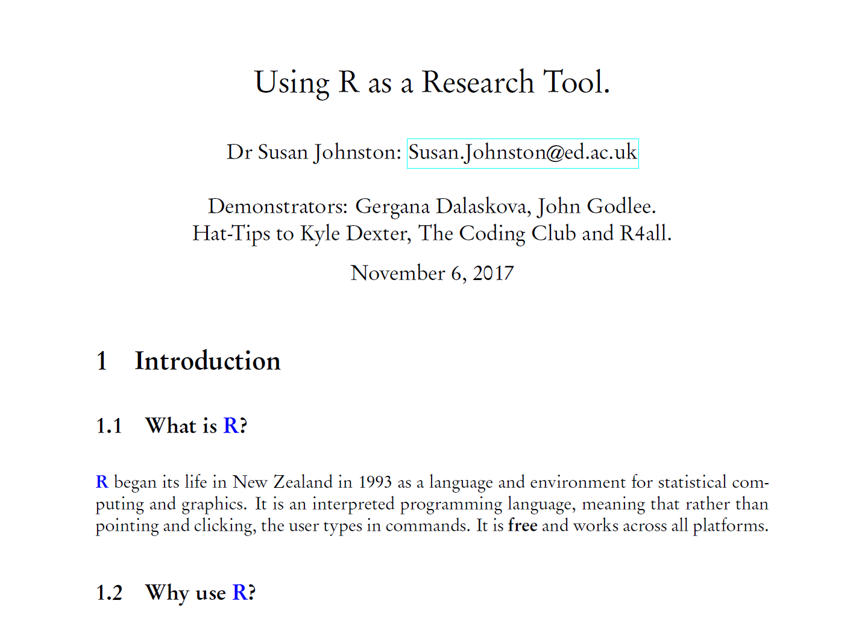
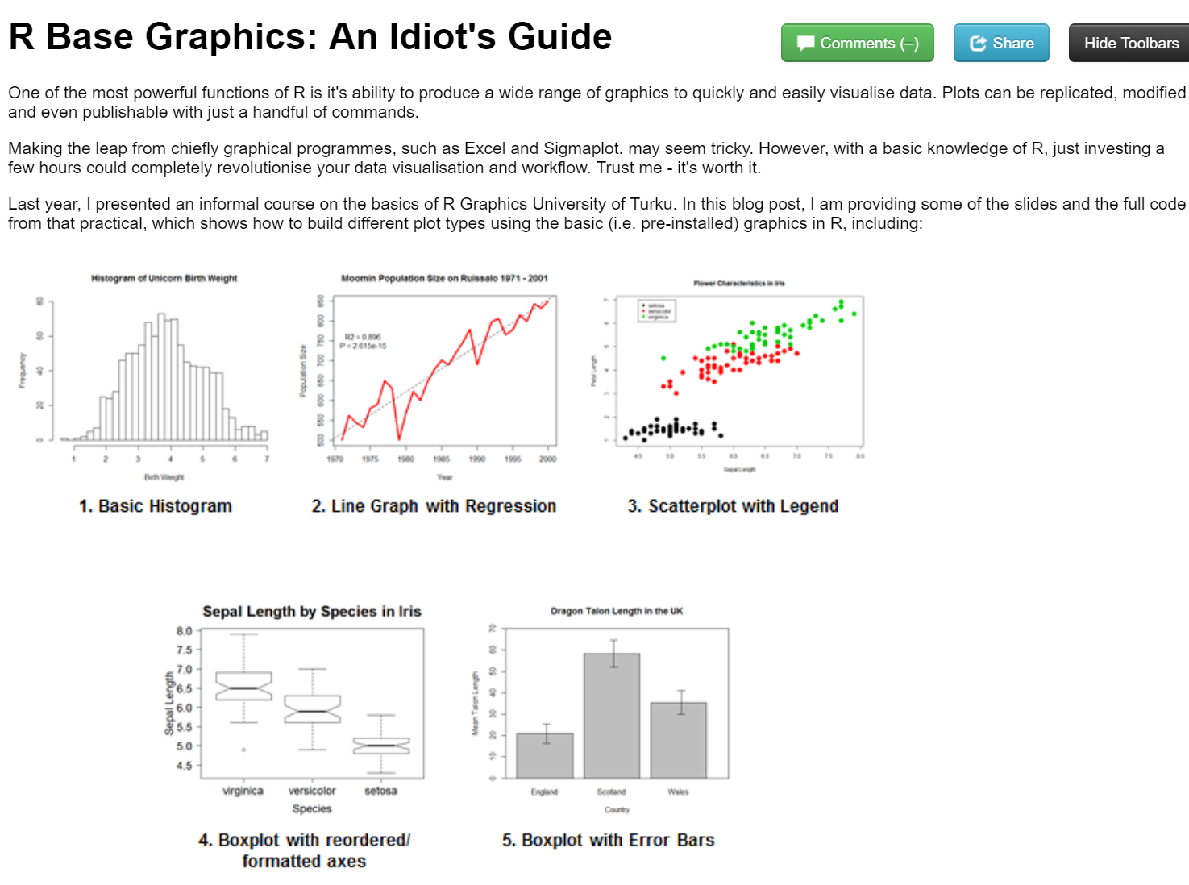
Report writing
LaTeX and R Sweave
knitr to HTML

Slide 7
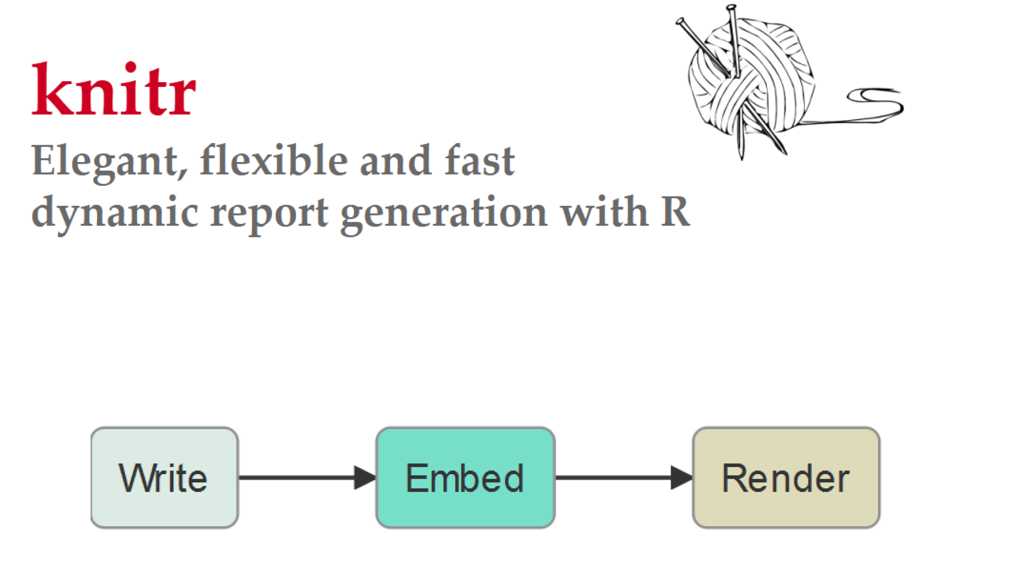
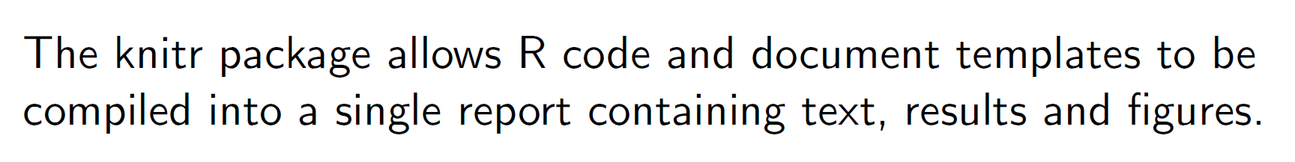

Slide 8
Markdown Language
Lightweight mark-up language
Basic text formatting, adding images, creating lists, etc.
Can embed code and results, making it useful for reproducible research.
Looks very much like regular text with a few extra characters (#, *, etc)
Notes:
formatting words as bold or italic, adding images, and creating lists are just a few of the things we can do with Markdown. Mostly, Markdown is just regular text with a few non-alphabetic characters thrown in, like # or *.

Slide 9
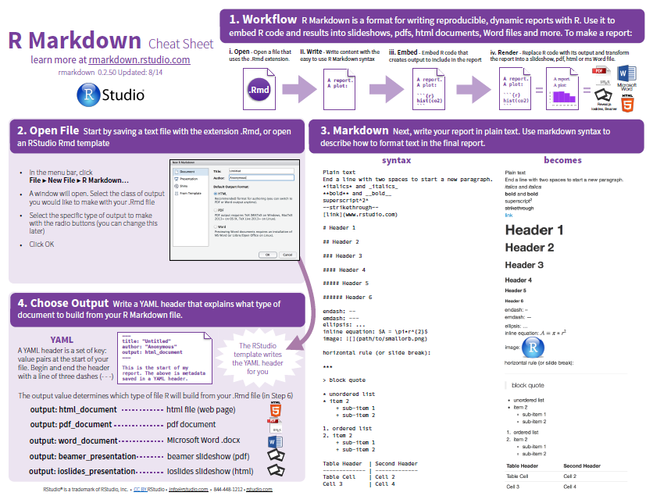

Slide 10
Worked example…

Slide 11
Today’s session:
Carry out basic statistics and visualisations, including:
Chi-squared test with chisq.test()
2-sample t-test with t.test()
Linear regression with lm()
Write, embed and render code and results into an HTML document.

Slide 12
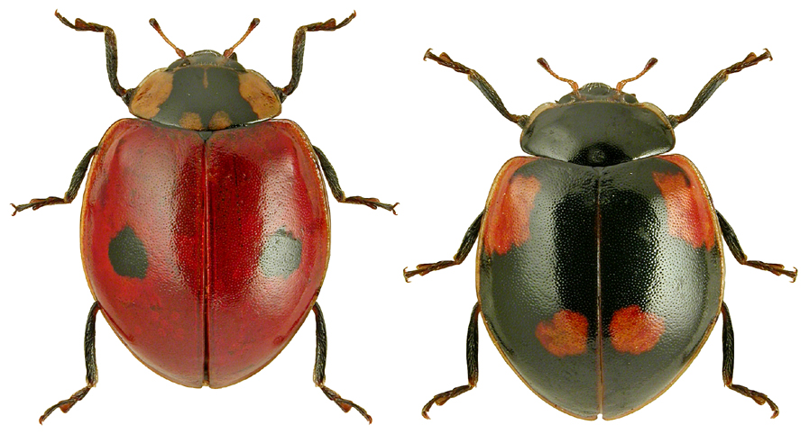
Chi-squared (χ²) contingency table
Analysis of count data
Are dark ladybirds more likely to live in industrial (dark) backgrounds?
Adalia bipunctata

Slide 13
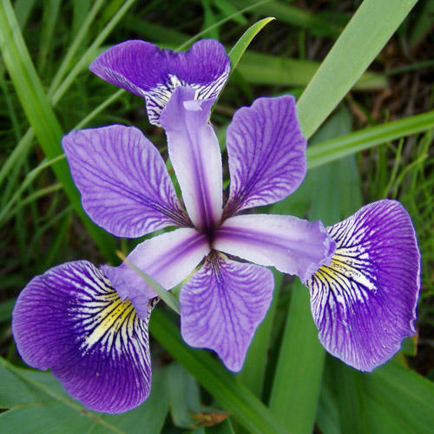
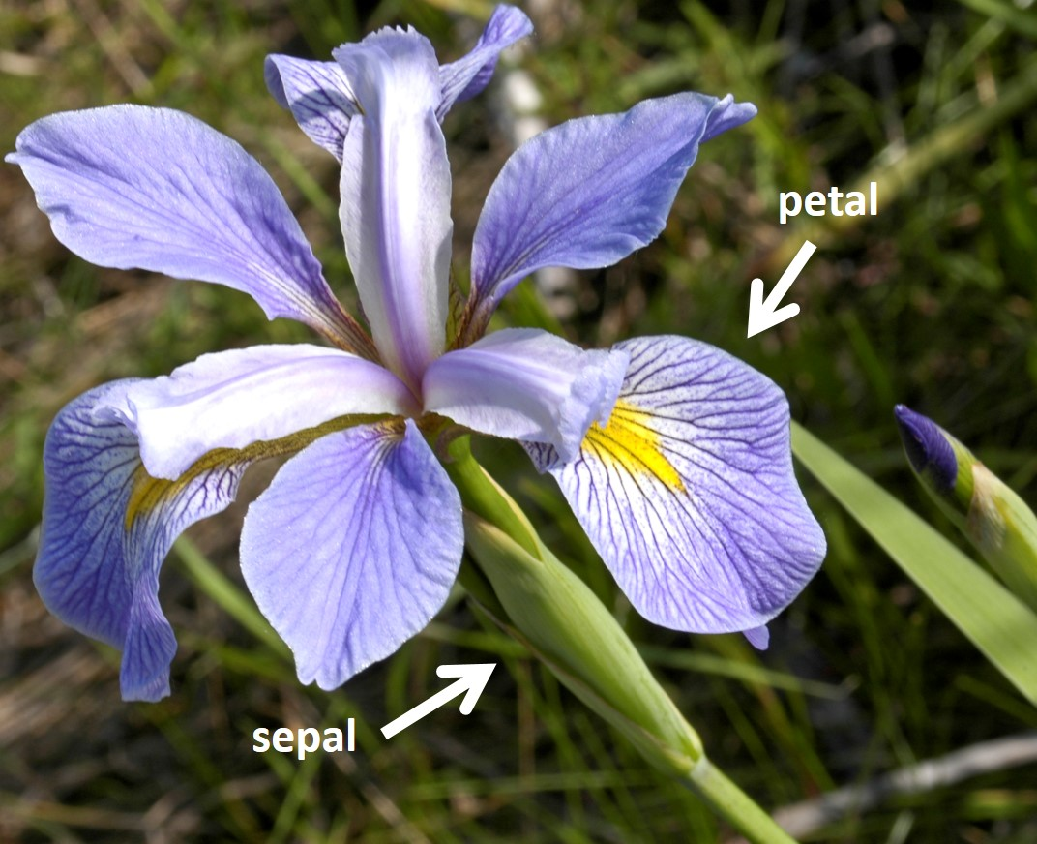
Two sample t-test
Compares the mean of two groups.
Are sepal lengths significantly different between these two species of Iris?
Iris versicolor Iris virginica

Slide 14
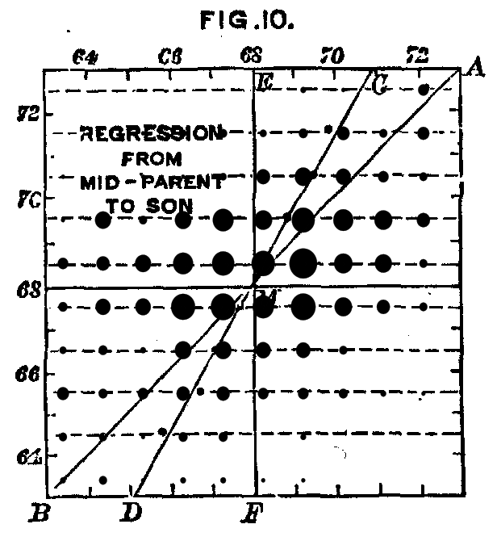
Simple linear regression
Summarise and study relationships between two continuous variables.
Francis Galton’s Human Height Data Set 1886
Does daughter height vary relative to the mean height of her parents?

Slide 15
Need help?
ASK US!
Use ?, str(), glimpse() to explore functions and objects.
Coding Club tutorials: https://ourcodingclub.github.io/tutorials/
Google & StackOverflow
Feel free to write as a normal R script!

